Slide 1

Parallel Programming
-Final Project-
N-Body Simulation
Team 20
Team Leader: 113062627 陳奕安
Team Members: 113062627 陳奕安 113062529 鄭凱元

Slide 2

Outline
Introduction
Implementation
Serial CPU Optimization
OpenMP
Hybrid (MPI + OpenMP)
CUDA Implementations

Slide 3
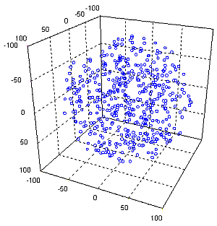
Introduction
Problem: N-body simulation.
Compute all-pairs gravitational forces between N particles and update positions/velocities over T timesteps.
Computational complexity:
  Per timestep: O(N²) force evaluations.
  Whole simulation: O(T · N²).
  End-to-end runtime includes compute + memory traffic + I/O (trajectory dump).

Slide 4
Introduction
Goal of this project:
  Speed up the simulation on CPU using:
    Serial CPU optimizations (baseline improvements)
    OpenMP (threaded)
    MPI + OpenMP (distributed + threaded hybrid)
  Speed up the simulation on GPU using:
    Naive GPU optimizations (baseline improvements)
    Shared Memory
    Structured of Array
    AMD MI100 Porting

Slide 5

Implementation
Execution environments
  CPU demo: Origo Cluster
  GPU demo: Apollo Cluster
Input/Output
  Input:
    Simulation parameters (N: number of particles, total_time: total simulated time, dt: time step size, dump_interval: output frequency (in timesteps))
    Initial state (Position, Velocity, Mass) (per particle)
  Output:
    Trajectory data (Positions and velocities of all particles over time).
Program structure (common pipeline)
  Input / initialization: Parse N, total_time, dt, dump_interval, allocate bodies & buffers.
  Core compute: compute_acceleration() : all-pairs force accumulation O(N²).
  Time integration: step_leapfrog() : update v($t+\frac{1}{2}$ ) (Velocity) → x($t+1$) (Position) → a($t+1$) (Acceleration) → v($t+1$) (Leapfrog).
  Trajectory output: Periodic CSV dump (controlled by dump_interval ).

Slide 6
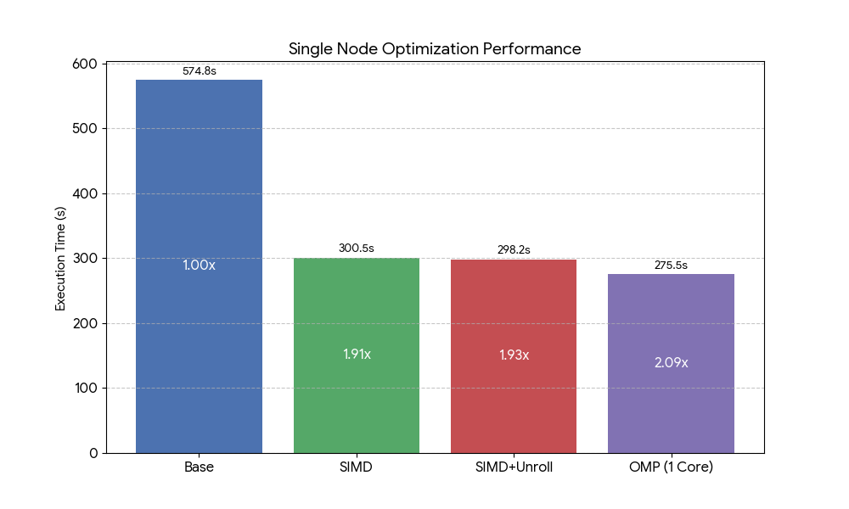
Serial CPU Optimization
Base
Naive serial implementation, AoS DataStruct.
Used as baseline (1.00×).
SIMD
Use vector instructions (SSE2) to compute multiple interactions per iteration.
Improve instruction-level parallelism.
~1.9× speedup.
SIMD + Unroll
Further loop unrolling to reduce loop overhead.
Better instruction scheduling and pipeline utilization.
Slight additional speedup over SIMD.
OMP (1 Core)
Enable OpenMP but restrict to single thread.
Performance slightly better due to compiler optimization.

Slide 7
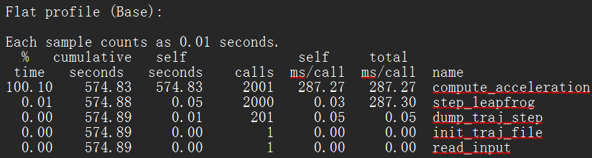
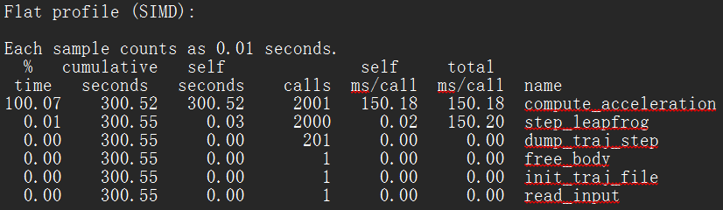
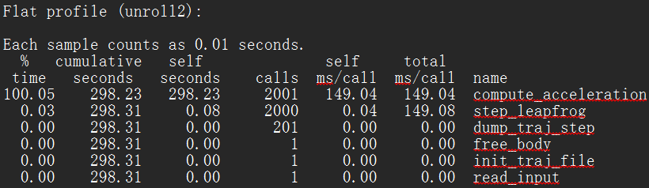
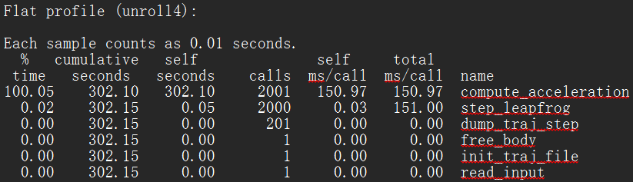
Profiling (N = 4096)
Tool: gprof
Observation
  compute_acceleration() dominates runtime. Other components are negligible.
Key takeaway
  Performance improvement comes almost entirely from optimizing the O(N²) force computation.
  Loop unrolling shows diminishing returns beyond a certain point

Slide 8
Speedup Table
Version | Time (s) | Step Speedup | Cumulative Speedup | 說明
Base | 574.83 | — | 1.00x | Baseline (原始版本)
SIMD | 300.52 | 1.91x | 1.91x | 加入 SSE 向量化
SIMD + Unroll | 298.23 | 1.01x | 1.93x | 額外進行 Loop Unrolling (提升微小)
OMP (1 Core) | 275.50 | 1.08x | 2.09x | OpenMP (-c1)

Slide 9
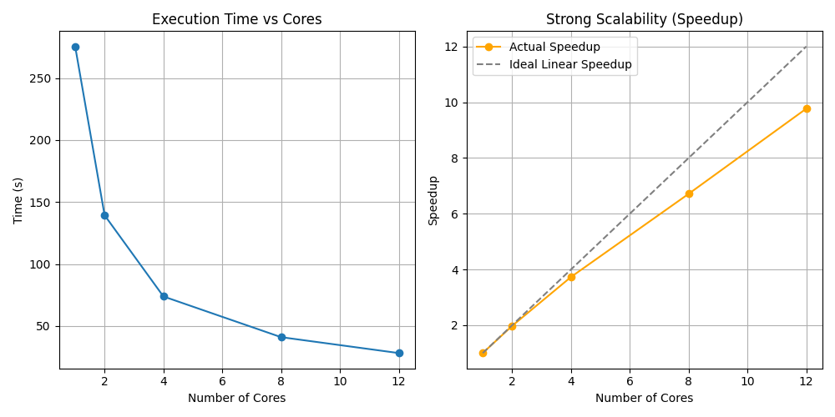
OpenMP Strong Scalability
Execution time
  Runtime decreases significantly as core count increases
  From ~275 s (1 core) to ~28 s (12 cores)
Speedup
  Achieves near-linear speedup up to moderate core counts
  ~9.8× speedup on 12 cores (ideal: 12×)
Reason
  Workload dominated by O(N²) compute_acceleration
  Minimal synchronization and OpenMP overhead
Limitation
  Deviation from ideal scaling due to
    Memory bandwidth contention
    OpenMP scheduling and synchronization overhead
Setup
  Fixed problem size (N = 4096)
  Vary number of CPU cores (1 → 12)
  Measure strong scalability

Slide 10
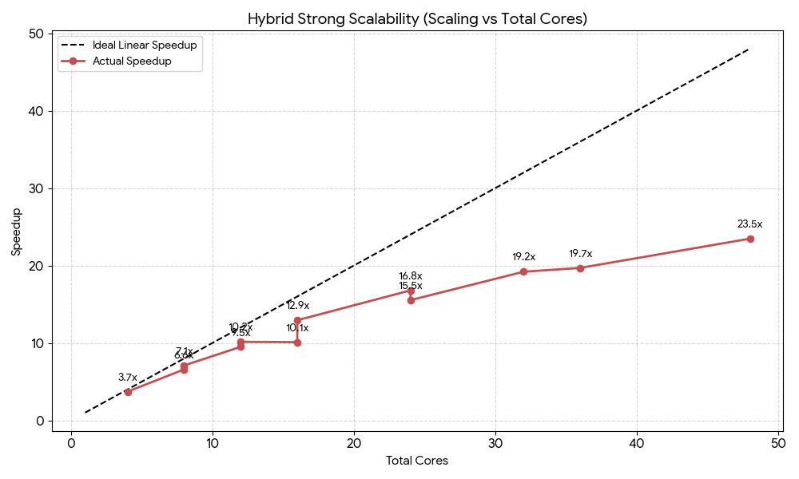
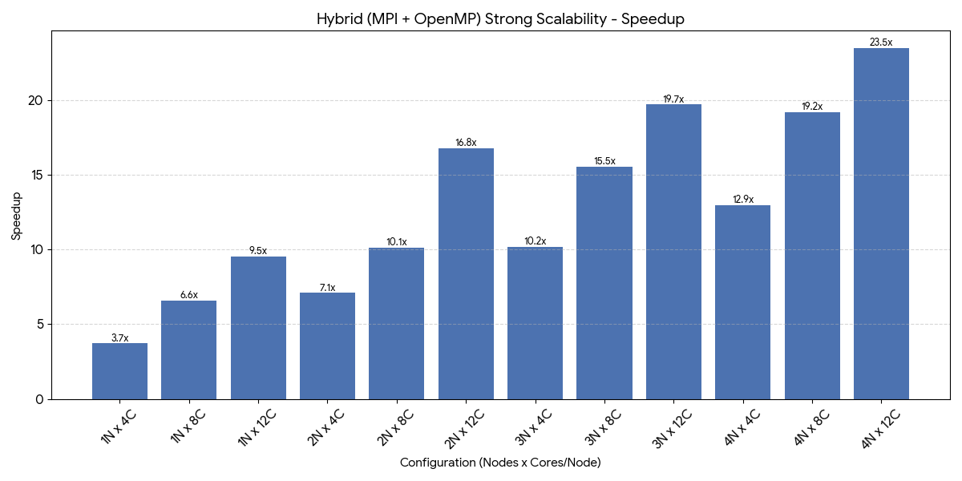
Hybrid Strong Scalability
Configuration | Total Cores | Time (s) | Speedup | Efficiency | 說明
1N x 4C | 4 | 74.20 | 3.71x | 92.8% | 單節點基準
1N x 8C | 8 | 41.83 | 6.59x | 82.3%
1N x 12C | 12 | 28.99 | 9.50x | 79.2% | 單節點最強效能
2N x 4C | 8 | 38.83 | 7.10x | 88.7% | 跨節點 (低通訊壓力)
2N x 8C | 16 | 27.26 | 10.11x | 63.2%
2N x 12C | 24 | 16.41 | 16.79x | 70.0% | 雙節點滿載
3N x 4C | 12 | 27.14 | 10.15x | 84.6%
3N x 8C | 24 | 17.74 | 15.53x | 64.7%
3N x 12C | 36 | 13.99 | 19.69x | 54.7% | 效率開始下降 (通訊佔比增高)
4N x 4C | 16 | 21.30 | 12.93x | 80.8%
4N x 8C | 32 | 14.35 | 19.20x | 60.0%
4N x 12C | 48 | 11.74 | 23.47x | 48.9% | 最高效能 (Peak Speedup)

Slide 11
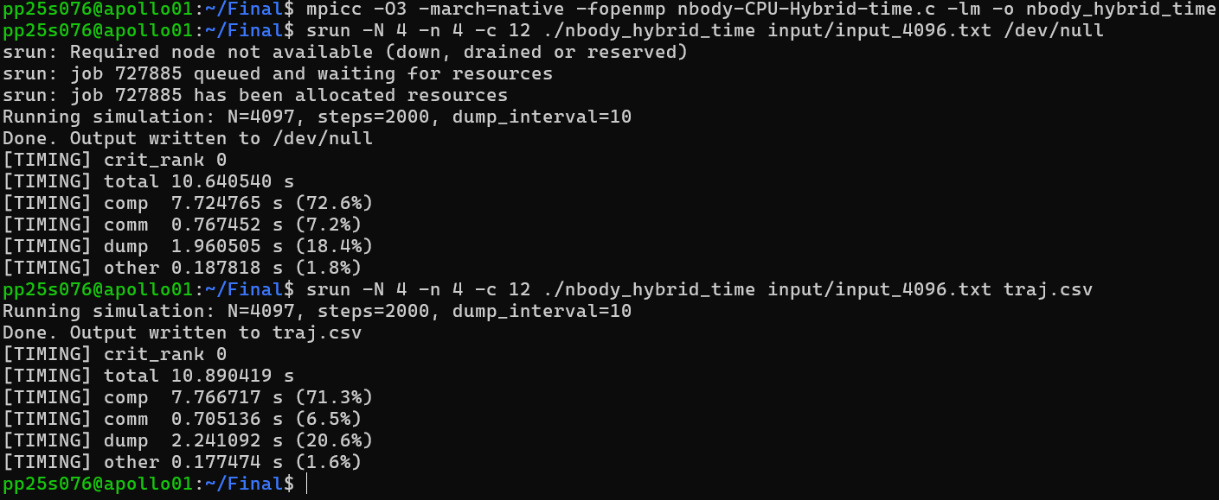
Execution Time Breakdown (MPI + OpenMP, N = 4096)

Slide 12
CUDA and GPU Implementations
Baseline Version (Baseline)
Baseline w/ Shared Memory using Tiled Block of Size 256 (SM, B=256)
SM w/ Structure of Arrays Memory Storage Pattern (SoA, B=256)
SoA w/ Tiled Block Size Tuning (SoA, B=64)
CUDA version directly ported to AMD HIP version (AMD-Ported)
Profiled w/ nvprof at N = 2048

Slide 13
CUDA Profiling Metrics
Global Memory Load Efficiency (`gld_efficiency`)
  Ratio of requested global memory load throughput to required global memory load throughput expressed as percentage.
Global Memory Store Efficiency (`gst_efficiency`)
  Ratio of requested global memory store throughput to required global memory store throughput expressed as percentage.
Shared Memory Store Transactions Per Request (`shared_store_transactions_per_request`)
  Average number of shared memory store transactions performed for each shared memory store.

Slide 14
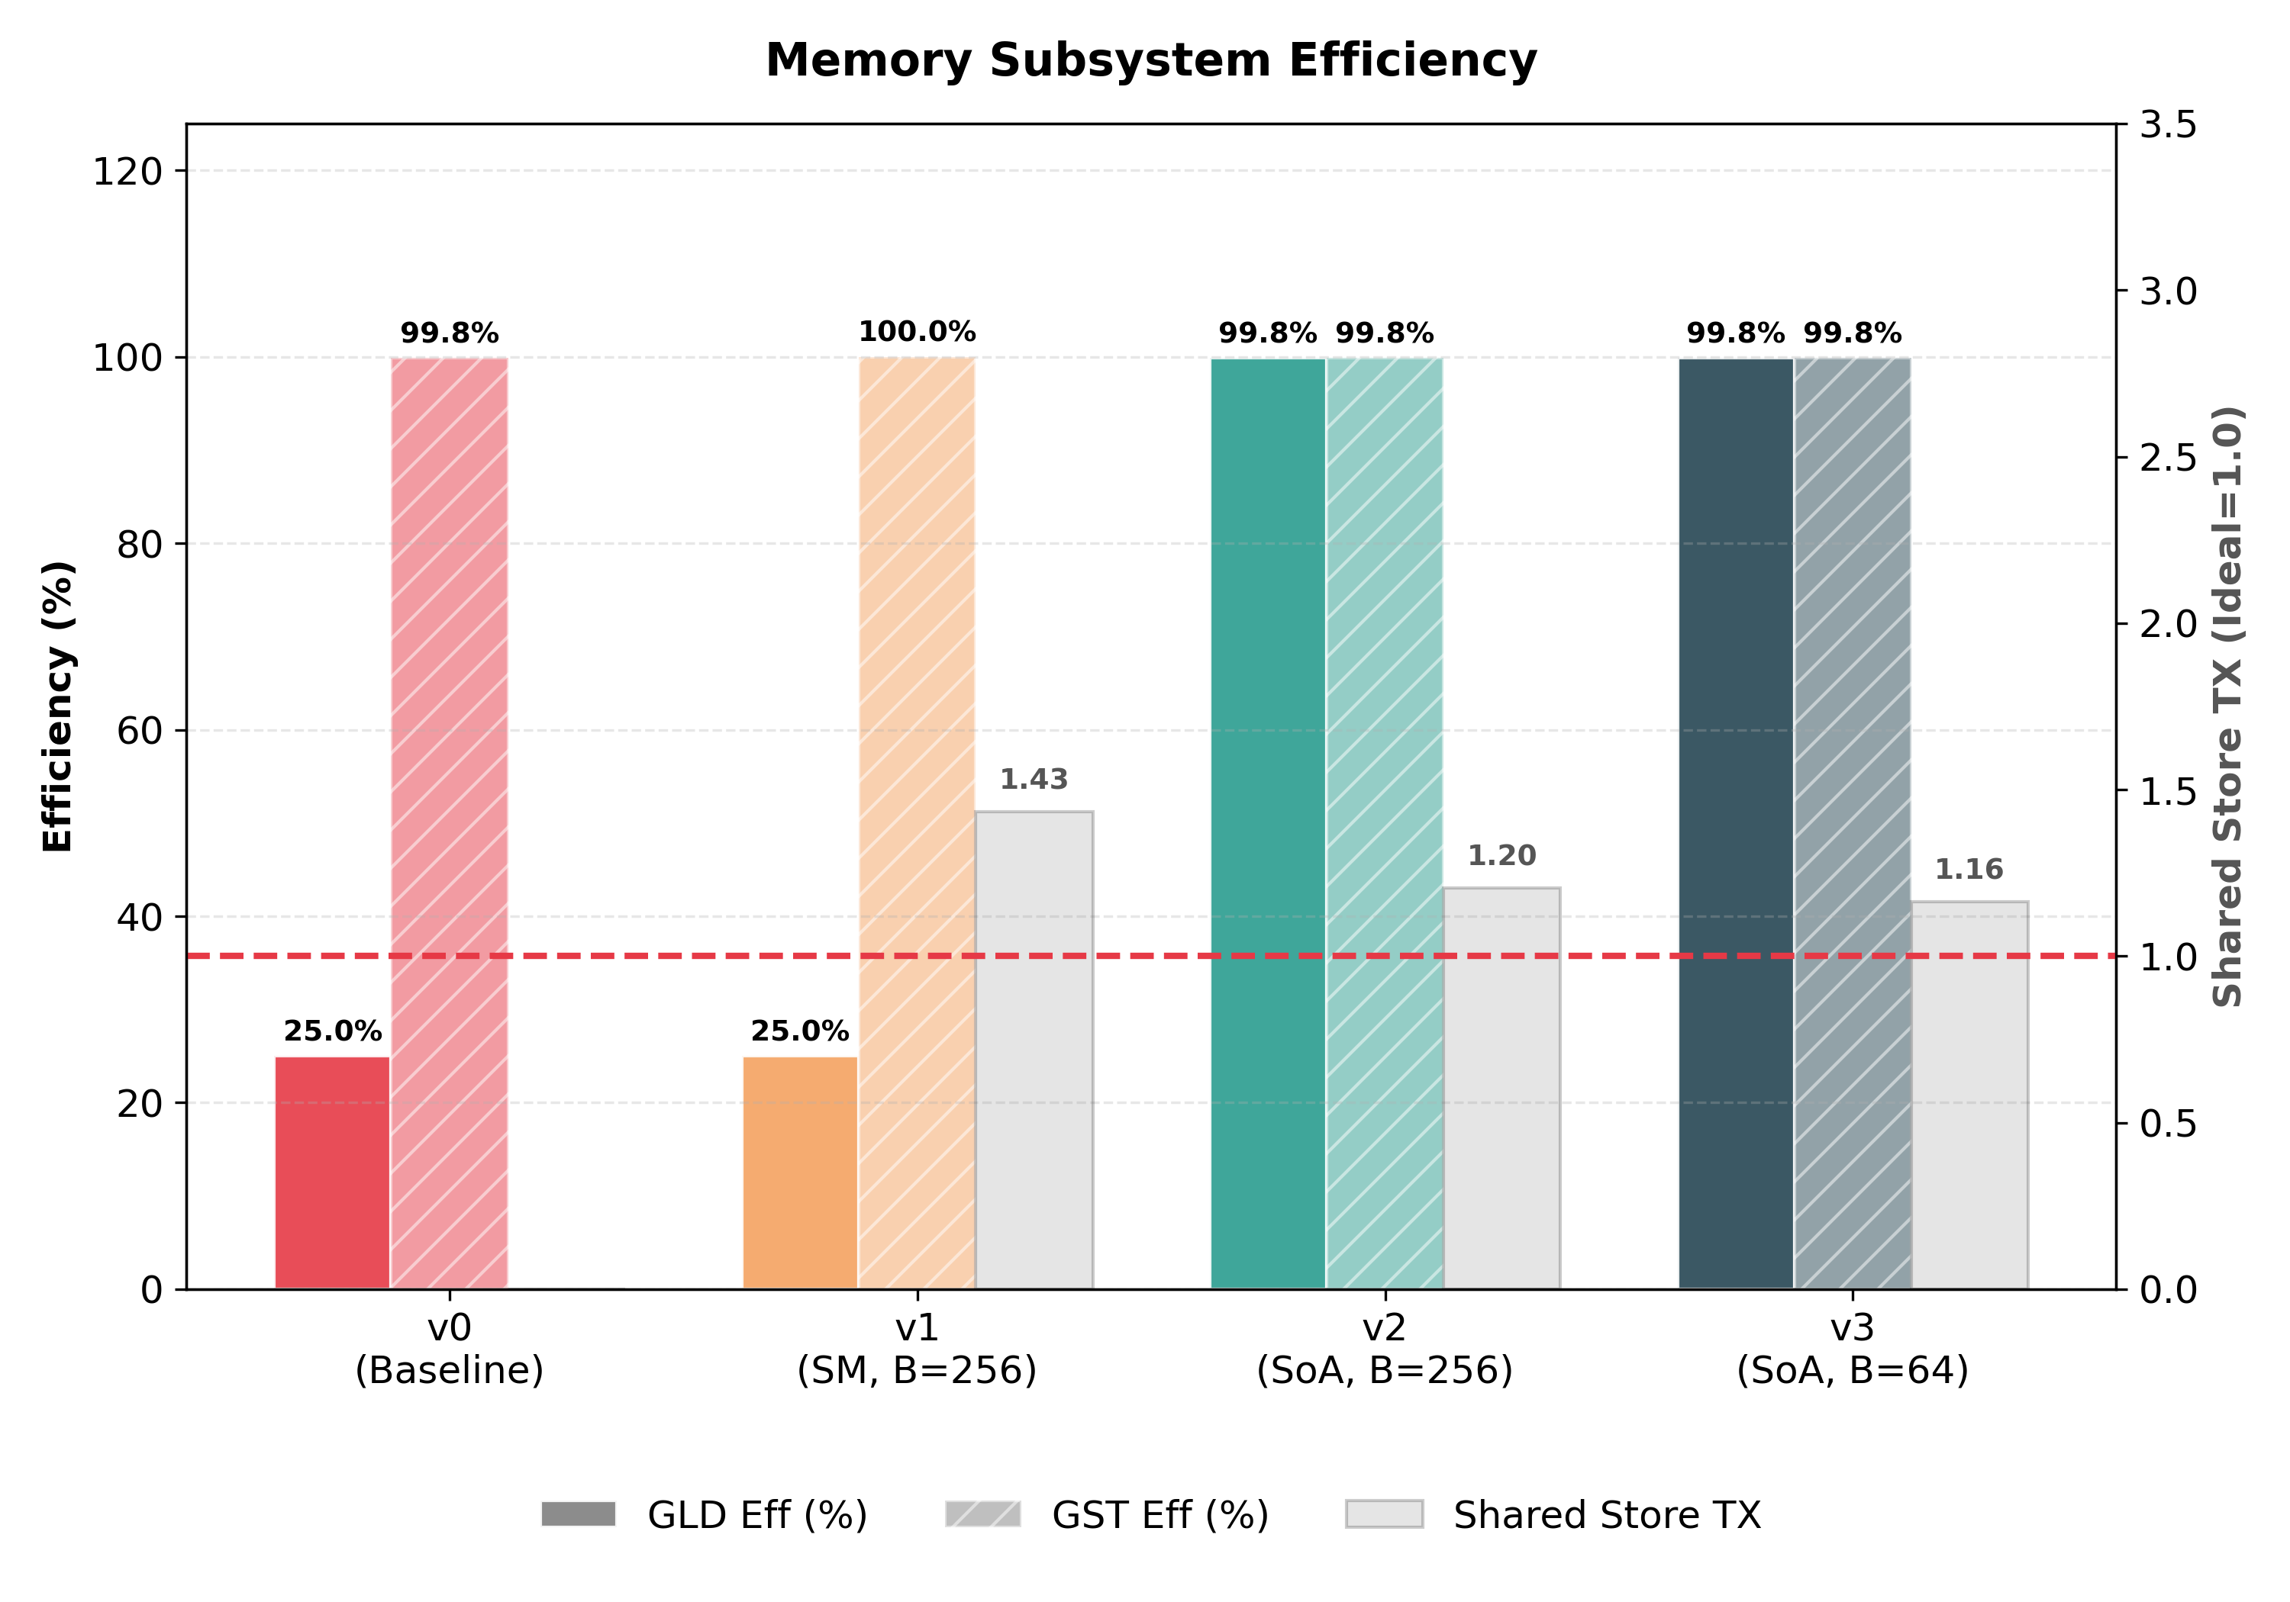
Memory Subsystem Efficiency
Observations:
  Array of Structs
    Non-Coalescing Memory Access (GLD Eff 25%)
    Shared Memory Bank Conflict (Shared Store TX 1.43)
  Structure of Arrays
    Coalescing Memory Access (GLD Eff 25% -> 99.8%)
    Reduced Bank Conflict (Shared Store TX 1.43 -> 1.20)
Conclusions:
  Memory Bound -> Compute Bound Problem
  FP64 Throughput Limitation from GTX 1080

Slide 15
CUDA Profiling Metrics
Multiprocessor Activity (`sm_efficiency`)
  The percentage of time at least one warp is active on a specific multiprocessor.
Achieved Occupancy (`achieved_occupancy`)
  Ratio of the average active warps per active cycle to the maximum number of warps supported on a multiprocessor.

Slide 16
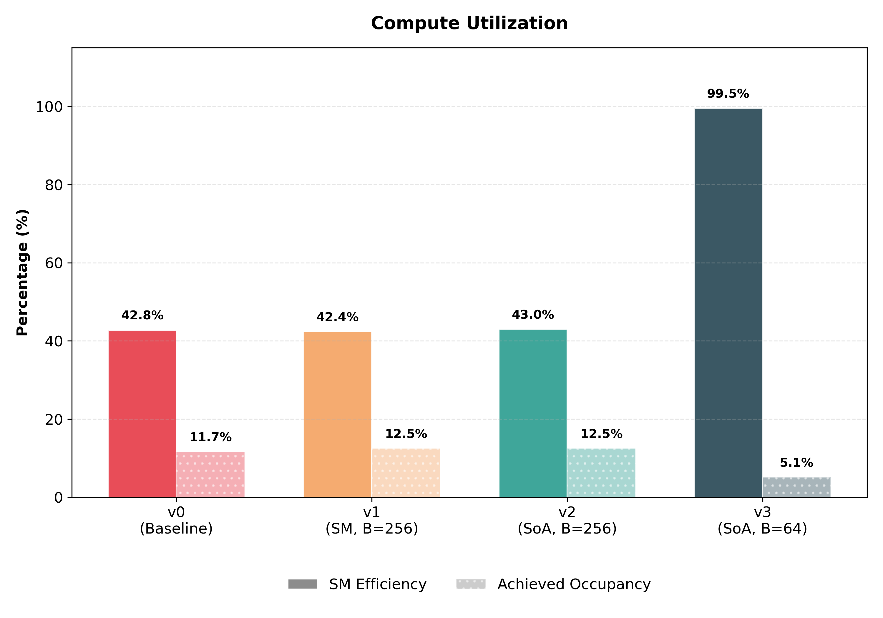
Compute Utilization
Observations:
  SM Efficiency
    Lot of Stalls => Warps waiting for Memory Read
    SoA resolved Memory Read Issue.
    However, w/ N = 2048, B = 256, 2048 / 256 = 8 blocks for 20 Streaming Multiprocessors => ~40% actives.
    2048 / 64 = 32 blocks => ~100% actives.
  Achieved Occupancy
    Naturally Low since the problem is too small.
    Acceptable since SM Efficiency is high.

Slide 17
CUDA Profiling Metrics
Issue Stall Reasons (Execution Dependency) (`stall_exec_dependency`)
  Percentage of stalls occurring because an input required by the instruction is not yet available.
Issue Stall Reasons (Data Request) (`stall_memory_dependency`)
  Percentage of stalls occurring because a memory operation cannot be performed due to the required resources not being available or fully utilized, or because too many requests of a given type are outstanding.
Issue Stall Reasons (Synchronization) (`stall_sync`)
  Percentage of stalls occurring because the warp is blocked at a __syncthreads() call.

Slide 18
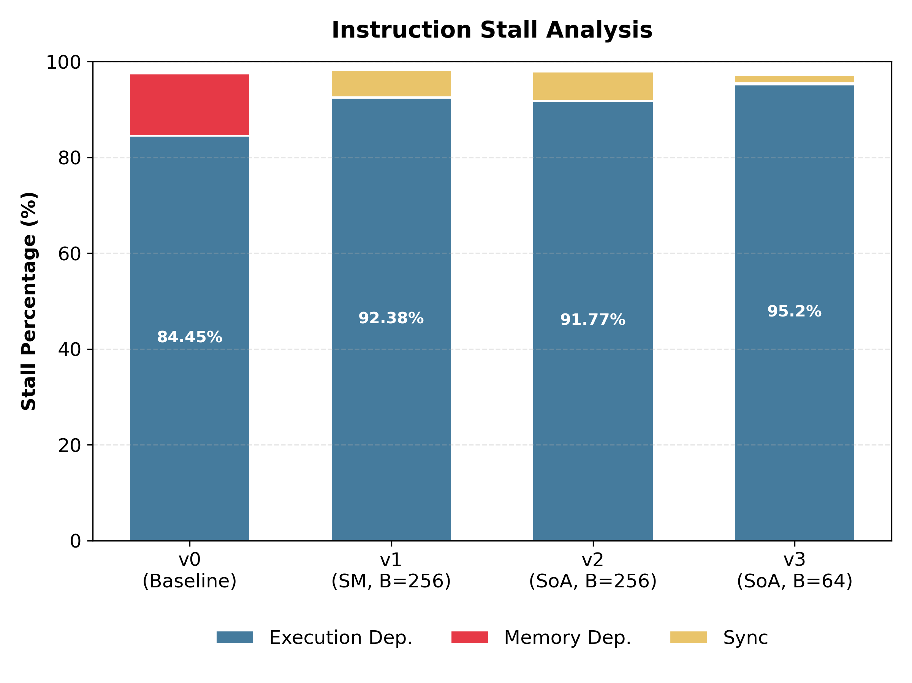
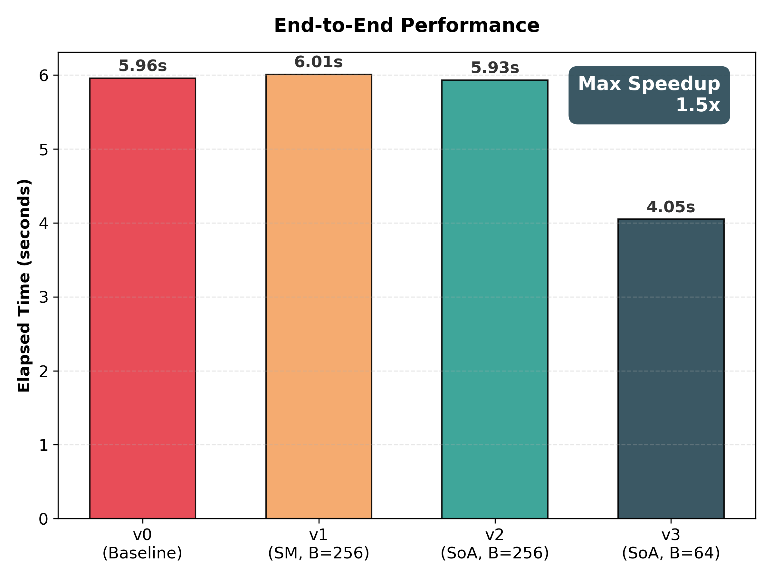
Instruction Stall Analysis
Observations:
  Baseline version: Dependency caused by Memory Dependency Stall is ~12% (red), then resolved via Shared Memory.
  Memory Dependency Stall becomes Synchronization Overhead w/ Shared Memory & SoA.
  The bottleneck proved to be the Execution Dependency Stall, since we use `sqrt ()` to maintain the precision.

Slide 19
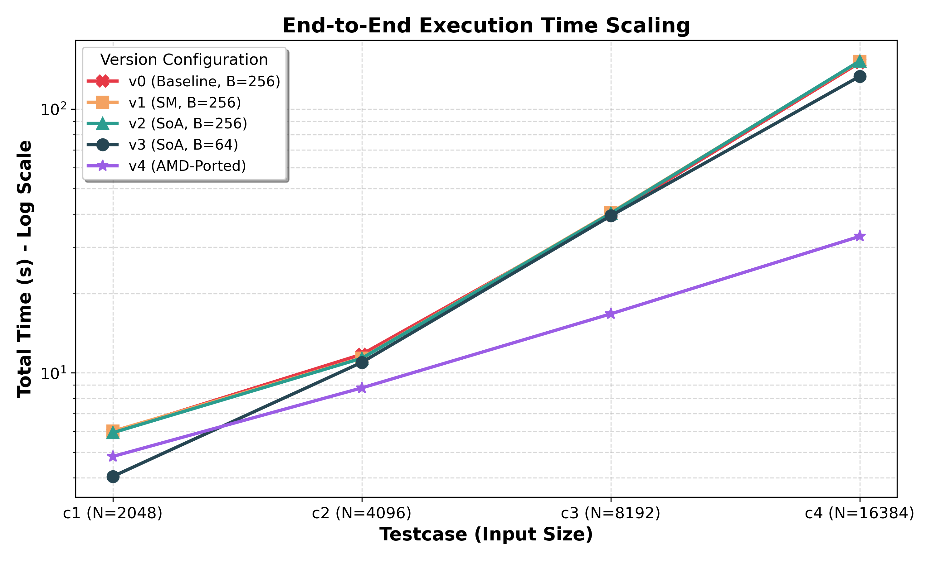
AMD Porting
Solved Problem: Memory Issue.
Unsolved Problem: Compute Bound caused by FP64 Precision Operation and NVIDIA GTX 1080’s Compute Limitation.
Solution: Porting to AMD MI100.
Results: w/ N = 16384, total time spend, reduced from 150s (v2) to 133s (v3), then to 33s (v4), speedup 4.5x.

